Slide 1
Domain Name System (DNS)
June 2015

Slide 2
Agenda
I. Introduction
II. Important DNS terminology:
IV. Advanced features
V. Tools
VI. Demo
VII. ALU DNS 6.0
VIII. References

Slide 3
Introduction
Using a host name is preferred when communicating over a network. Easily remembered than an IP address
Before 1982, HOSTS.TXT is used to map names to numerical addresses and each computer retrieved this file a computer at SRI
The rapid growth of the network made a centrally maintained, hand-crafted HOSTS.TXT unsustainable
A more scalable system is needed so Domain Name System (DNS) was invented in 1983

Slide 4
Introduction
DNS is a hierarchical distributed naming system for computers, services, or any resource connected to the Internet or a private network
Resolves queries for domain names into IP addresses.
An essential component of the functionality of the Internet.
The DNS protocol defines a set of messages sent over either User Datagram Protocol (UDP) port 53 or Transmission Control Protocol (TCP) port 53.

Slide 5
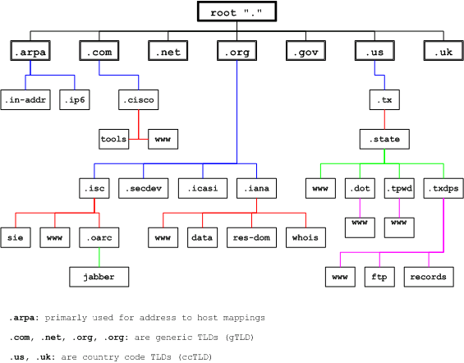
Introduction
The DNS namespace is based on a hierarchical and logical tree structure.

Slide 6
Important DNS terminology
Domain namespace, Domain name, Domain and subdomain
Domain namespace is the structure of the DNS database. A domain namespace that will contain a "tree" of domain names.
Domain name: Each node in the tree has a private label. An empty label representing the root. A full domain name of any node in the "tree" is the order of the labels in the path from that node to the root.
A domain is a branch of the namespace. The domain is the set of nodes that have the same parent node, this node creates a domain.
Domains can be further partitioned at node points within the domain into subdomains for the purposes of administration or load balancing.

Slide 7
Important DNS terminology
Domain com.au
The ausregistry.com.au sub-domain of com.au

Slide 8
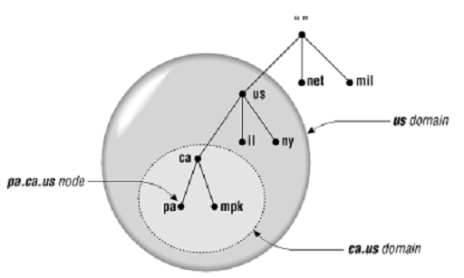
Important DNS terminology
TLD (Top level domain): child of root
The top of the hierarchy is served by the root nameservers, the servers to query when looking up (resolving) a TLD.
Us, vn are ccTLDs (country code TLD)
Mil, net are gTLDs (Generic TLD)

Slide 9
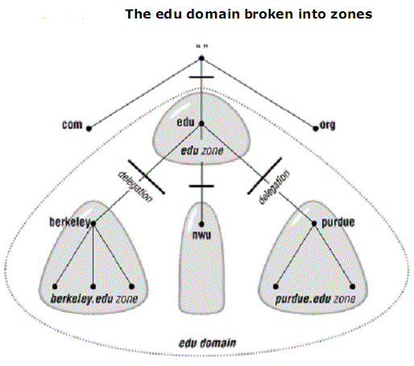
Important DNS terminology
Name Server
Name server: The programs that store information about the domain name space.
Name servers generally have complete information a zone, which they load from a file or from another name server.
The name server is then said to have authority for that zone
The name server is then said to have authority for that zone

Slide 10
Important DNS terminology
Name Server
DNS defines two types of name servers:
Primary name server: is the primary DNS server, which contains all the information for domain, allowed to add, delete, edit your DNS DATABASE
Secondary name server: is the DNS server, backup, DATABASE of the Primary again. Not change the DNS DATABASE. In case the Primary name server is fail, the Secondary is used for name resolution
There is also a Caching-only servers are DNS servers that only perform queries, cache the answers, and return the results.

Slide 11
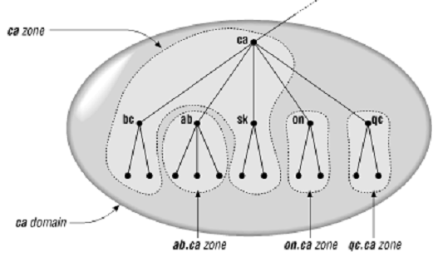
Important DNS terminology
Domain name and zone
Zone and domain can share the domain name (ca) but contain different node
Domain name ca contains all data in ca + all data in ab.ca, on.ca and qc.ca
Zone ca only contains all data in ca

Slide 12
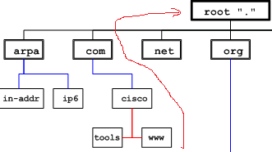
Important DNS terminology
Fully Qualified Domain Name (FQDN)
A fully qualified domain name (FQDN) is a DNS domain name that has been constructed from its location relative to the root of the namespace (known as the root domain).
FQDN: www.cisco.com.”

Slide 13
Important DNS terminology
Types of Queries
Recursive queries:
“.” root NS
2
8
3
Local NS
9
1
www.tma.com.vn
Vn. ns
10
4
www.tma.com.vn A IN 221.133.0.1
7
com.vn. ns
5
6
Tma.com.vn. ns

Slide 14
Important DNS terminology
Types of Queries
“.” root NS
Iterative queries:
4 ask vn
3
6 ask com.vn
1
Vn. ns
www.tma.com.vn
Local NS
2 ask root
5
9 www.tma.com.vn IN A 221.133.0.1
8 ask tma.com.vn
7
8
com.vn. ns
Tma.com.vn. ns

Slide 15
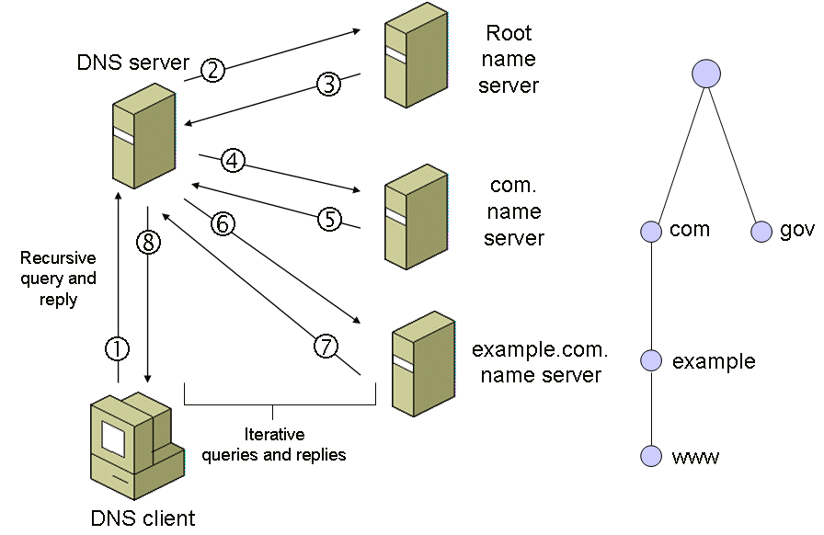
Important DNS terminology
Types of Queries
Real deployment:

Slide 16
Important DNS terminology
Resource Record
A domain contains resource records
Resource records are analogous to files
Classified into types
Some of the important types are SOA, NS, A, AAAA*, CNAME and MX
Normally defines in “zone files”

Slide 17
Important DNS terminology

